Slide 1
Statistics for Analytics (BAN 100)
Assignment 4
by : Aaron Gonsalves
(161288196)

Slide 2
CODES
data fitness; input age weight oxy runtime rstpulse runpulse maxpulse; case = _n_; label age='Age of man' weight='Weight of man' oxy='Oxygen consumption' runtime='Time to run 1.5 miles' rstpulse='Resting pulse rate' runpulse='Pulse rate while running' maxpulse='Maximum pulse rate’
case='Case no.'; datalines; 44 89.47 44.609 11.37 62 178 182 40 75.07 45.313 10.07 62 185 185 44 85.84 54.297 8.65 45 156 168 42 68.15 59.571 8.17 40 166 172 38 89.02 49.874 9.22 55 178 180 47 77.45 44.811 11.63 58 176 176 40 75.98 45.681 11.95 70 176 180 43 81.19 49.091 10.85 64 162 170 44 81.42 39.442 13.08 63 174 176 38 81.87 60.055 8.63 48 170 186 44 73.03 50.541 10.13 45 168 168 45 87.66 37.388 14.03 56 186 192 45 66.45 44.754 11.12 51 176 176 47 79.15 47.273 10.60 47 162 164 54 83.12 51.855 10.33 50 166 170 49 81.42 49.156 8.95 44 180 185

Slide 3
51 69.63 40.836 10.95 57 168 172 51 77.91 46.672 10.00 48 162 168 48 91.63 46.774 10.25 48 162 164 49 73.37 50.388 10.08 67 168 168 57 73.37 39.407 12.63 58 174 176 54 79.38 46.080 11.17 62 156 165 52 76.32 45.441 9.63 48 164 166 50 70.87 54.625 8.92 48 146 155 51 67.25 45.118 11.08 48 172 172 54 91.63 39.203 12.88 44 168 172 51 73.71 45.790 10.47 59 186 188 57 59.08 50.545 9.93 49 148 155 49 76.32 48.673 9.40 56 186 188 48 61.24 47.920 11.50 52 170 176 52 82.78 47.467 10.50 53 170 172 run ;
title "Details of fitness dataset:"; proc contents data=fitness varnum; run; title "Listing Fitness data:"; proc print data=fitness; run; title "Performing Corr procedure:"; proc corr data=fitness plots=matrix(hist nvar=7); var age weight oxy runtime rstpulse runpulse maxpulse; run;

Slide 4
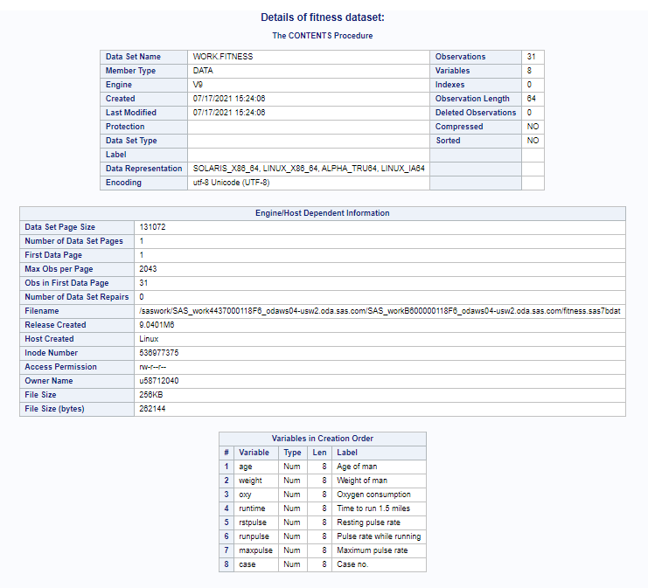

Slide 5
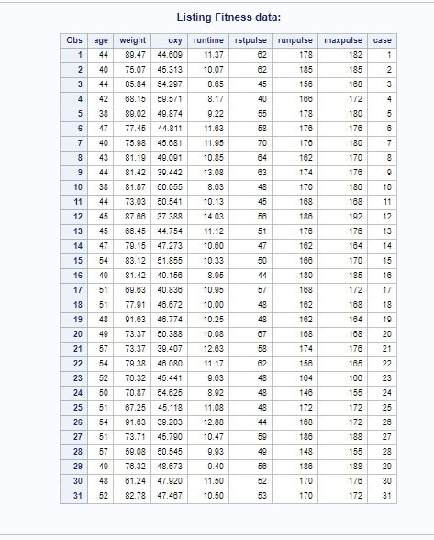

Slide 6
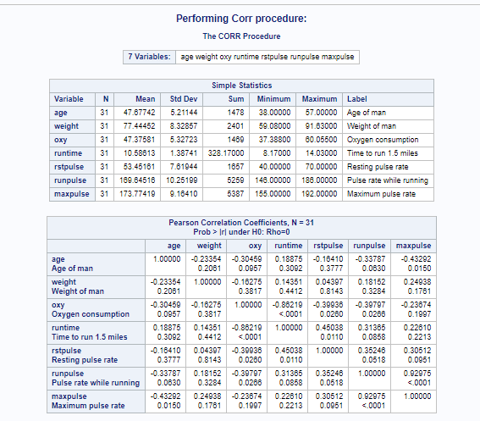

Slide 7
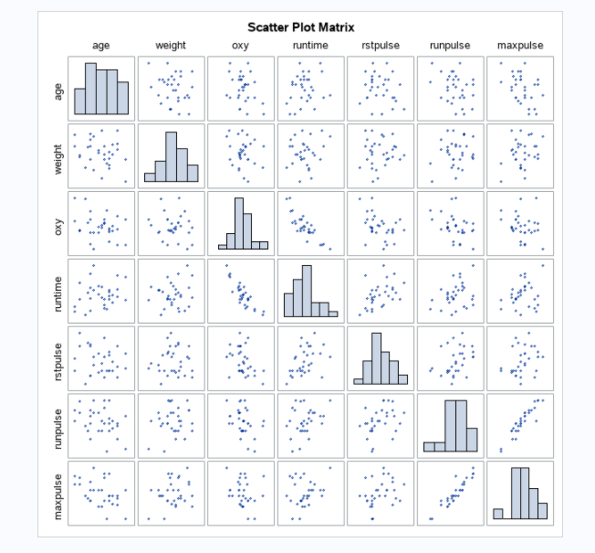

Slide 8
HYPOTHESIS 1
Determining whether there is relationship between age and maximum pulse rate.
Null Hypothesis(H₀): | Age and maximum pulse rate are independent variables.
Alternative Hypothesis(H_{a}): | Age and maximum pulse rate are dependent variables.

Slide 9
Interpretation
There is a 5% significance level, P-value is 0.0150 and value of correlation co-efficient is -0.43292.
As P-value<0.05, Null hypothesis (H₀) is rejected which considered age and maximum pulse rate as independent variables, and there is much evidence in support of Alternative Hypothesis(H_{a}).
As correlation co-efficient is -0.43292 i.e. between -0.25 & -0.5 , there is a weak negative association.

Slide 10
Conclusion
As Null hypothesis (H₀) is rejected from our interpretation, the conclusion is in support of Alternative Hypothesis(H_{a}).
This deduces that age and maximum pulse rate are dependent on each other, and as Age increases maximum pulse rate decreases.

Slide 11
HYPOTHESIS 2
Determining whether there is relationship between Oxygen consumption and runtime.
Null Hypothesis(H₀): | Oxygen consumption and runtime are independent variables.
Alternative Hypothesis(H_{a}): | Oxygen consumption and runtime are dependent variables.

Slide 12
Interpretation
There is a 5% significance level, P-value is less than 0.0001 and value of correlation co-efficient is -0.86219.
As P-value<0.05, Null hypothesis (H₀) is rejected which considered oxygen consumption and runtime as independent variables, and there is much evidence in support of Alternative Hypothesis(H_{a}).
As correlation co-efficient is -0.86219 i.e. between -0.75 & -1 , there is a strong negative association.

Slide 13
Conclusion
As Null hypothesis (H₀) is rejected from our interpretation, the conclusion is in support of Alternative Hypothesis(H_{a}).
This deduces that oxygen consumption and runtime are dependent on each other, and as runtime decreases oxygen consumption increases.

Slide 14
HYPOTHESIS 3
Determining whether there is relationship between Oxygen consumption and Resting pulse rate.
Null Hypothesis(H₀): | Oxygen consumption and Resting pulse rate are independent variables.
Alternative Hypothesis(H_{a}): | Oxygen consumption and Resting pulse rate are dependent variables.

Slide 15
Interpretation
There is a 5% significance level, P-value is 0.0260 and value of correlation co-efficient is -0.39936.
As P-value<0.05, Null hypothesis (H₀) is rejected which considered Oxygen consumption and Resting pulse rate as independent variables, and there is much evidence in support of Alternative Hypothesis(H_{a}).
As correlation co-efficient is -0.39936 i.e. between -0.25 & -0.5 , there is a weak negative association.

Slide 16
Conclusion
As Null hypothesis (H₀) is rejected from our interpretation, the conclusion is in support of Alternative Hypothesis(H_{a}).
This deduces that Oxygen consumption and Resting pulse rate are dependent on each other, and as resting pulse decreases oxygen consumption increases.

Slide 17
HYPOTHESIS 4
Determining whether there is relationship between Oxygen consumption and Pulse rate while running.
Null Hypothesis(H₀): | Oxygen consumption and Pulse rate while running are independent variables.
Alternative Hypothesis(H_{a}): | Oxygen consumption and Pulse rate while running are dependent variables.

Slide 18
Interpretation
There is a 5% significance level, P-value is 0.0266 and value of correlation co-efficient is -0.39797.
As P-value<0.05, Null hypothesis (H₀) is rejected which considered Oxygen consumption and Pulse rate while running as independent variables, and there is much evidence in support of Alternative Hypothesis(H_{a}).
As correlation co-efficient is -0.39797 i.e. between -0.25 & -0.5 , there is a weak negative association.

Slide 19
Conclusion
As Null hypothesis (H₀) is rejected from our interpretation, the conclusion is in support of Alternative Hypothesis(H_{a}).
This deduces that Oxygen consumption and Pulse rate while running are dependent on each other, and as Pulse rate while running decreases oxygen consumption increases.

Slide 20
HYPOTHESIS 5
Determining whether there is relationship between runtime and Resting Pulse Rate.
Null Hypothesis(H₀): | Runtime and Resting Pulse Rate are independent variables.
Alternative Hypothesis(H_{a}): | Runtime and Resting Pulse Rate are dependent variables.

Slide 21
Interpretation
There is a 5% significance level, P-value is 0.0110 and value of correlation co-efficient is 0.45038.
As P-value<0.05, Null hypothesis (H₀) is rejected which considered runtime and Resting Pulse Rate as independent variables, and there is much evidence in support of Alternative Hypothesis(H_{a}).
As correlation co-efficient is 0.45038 i.e. between 0.25 & 0.5 , there is a weak positive association.

Slide 22
Conclusion
As Null hypothesis (H₀) is rejected from our interpretation, the conclusion is in support of Alternative Hypothesis(H_{a}).
This deduces that runtime and Resting Pulse Rate are dependent on each other, and as runtime increases, Resting Pulse Rate also increases.

Slide 23
HYPOTHESIS 6
Determining whether there is relationship between Pulse rate while running and maxpulse.
Null Hypothesis(H₀): | Pulse rate while running(runpulse) and maxpulse are independent variables.
Alternative Hypothesis(H_{a}): | Pulse rate while running(runpulse) and maxpulse are dependent variables.

Slide 24
Interpretation
There is a 5% significance level, P-value is less than 0.0001 and value of correlation co-efficient is 0.92975.
As P-value<0.05, Null hypothesis (H₀) is rejected which considered Pulse rate while running and maxpulse as independent variables, and there is much evidence in support of Alternative Hypothesis(H_{a}).
As correlation co-efficient is 0.92975 i.e. between 0.75 & 1 , there is a strong positive association.

Slide 25
Conclusion
As Null hypothesis (H₀) is rejected from our interpretation, the conclusion is in support of Alternative Hypothesis(H_{a}).
This deduces that Pulse rate while running and maxpulse are dependent on each other, and as Pulse rate while running increases, maxpulse also increases.

Slide 26
Results from Correlation procedure and scatterplot
Based on the interpretations and conclusions from above hypothesis’ a clear relation between following variables is found.
Age and maxpulse
Oxygen consumption and runtime
Oxygen consumption and Resting Pulse Rate
Oxygen consumption and Pulse rate while running (runpulse)
Runtime and restpulse
Pulse rate while running (runpulse) and maxpulse

Slide 27
Limitations of Correlation Coefficient for Fitness Data
They are based on linear association, sample size and outliers.
r - co-efficient of correlation is a measure of linear association, and in fitness data all curves are linear, which shows that r value is good enough to predict the association.
The sample size is 31, which is sufficient enough, so the value of correlation co-efficient is reliable and good enough to predict the association.
Fitness data does not have outliers in it, so value of correlation co-efficient is good enough to predict the association.

Slide 28
THANK YOU

